Slide 1
Hello, CSS
CTEC 130

Slide 2
Getting Started

Slide 3
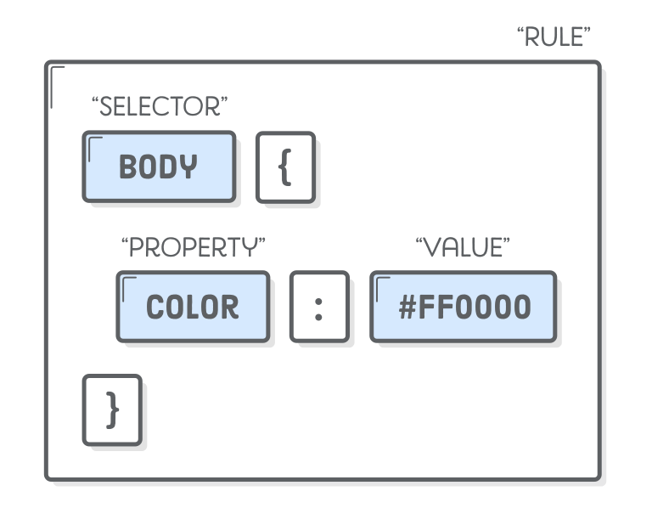
CSS Syntax

Slide 4
CSS Comments
/* look like this */

Slide 5
Common Measurement Units
px
pt
em
%
in, cm, mm
Maybe not so common…

Slide 6
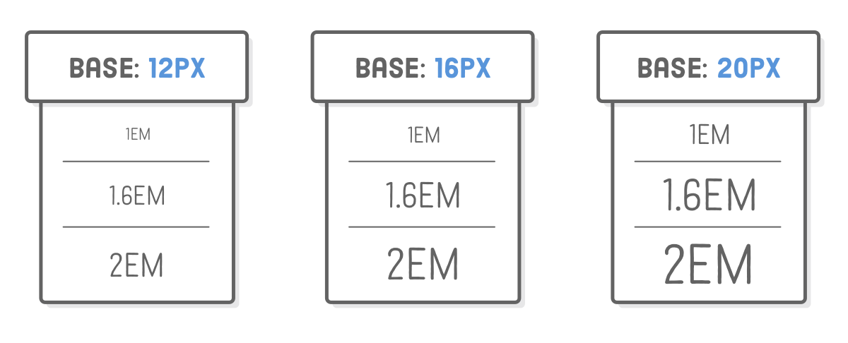
Text Measurement

Slide 7
Implementing Styles
Linking a stylesheet
<link rel=”stylesheet” href=”mystylesheet.css”>
In-page styles
<style> body { color: #0000FF; } </style>
Placed in the <head>
In-line styles
<a href=”nowhere.html” style=”color: #990000; text-decoration: line-through;”>bad link</a>
Used as the value of the style attribute
Prefer external stylesheets whenever possible

Slide 8
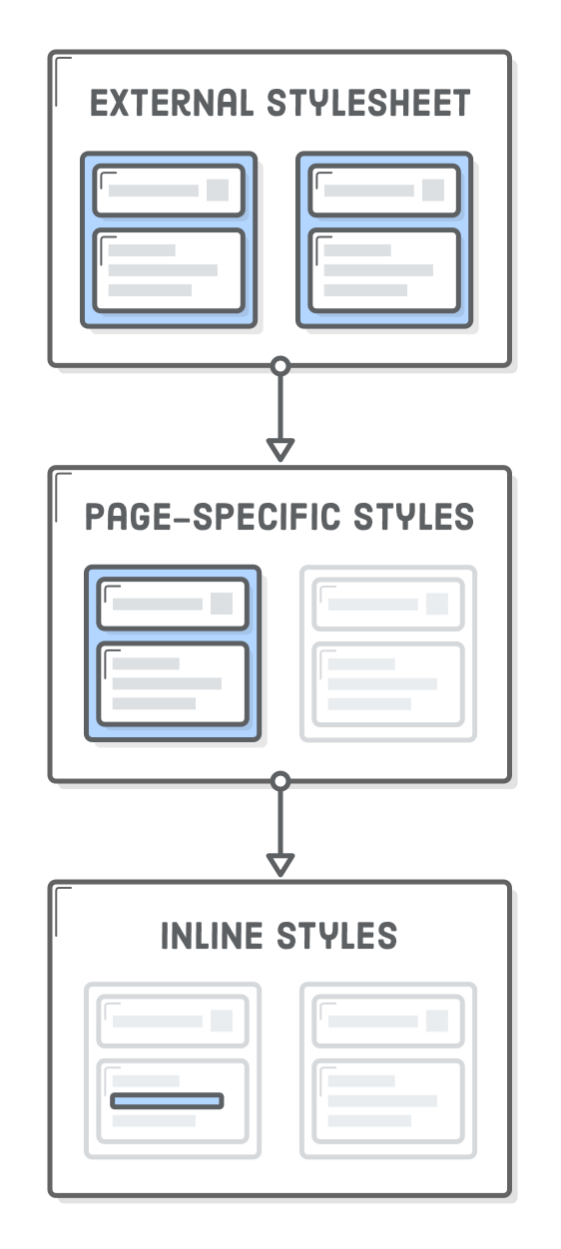
The Cascade

Slide 9
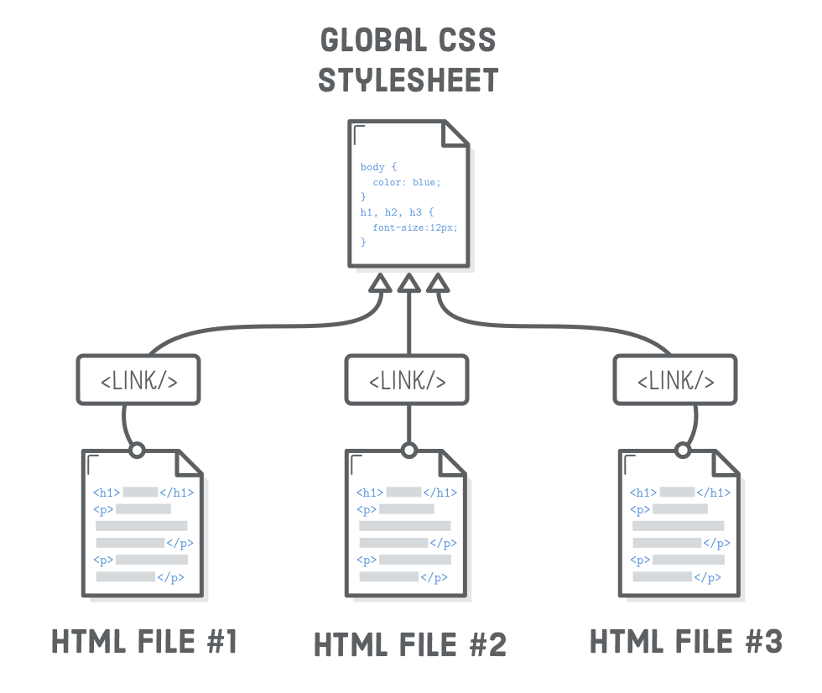
An Advantage of a Linked Stylesheet

Slide 10
Classes and IDs

Slide 11
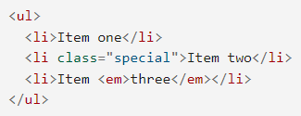

Classes
An attribute you can add to just about any tag
Allows you to specify a special label for targeting with CSS or JS
When targeting with CSS, write with a . before the name
You can use the same name on multiple tags

Slide 12
IDs
Like Classes, but for unique content on a page
Unlike a class, you can’t re-use a specific ID on the same page
When targeting in CSS, use a # before the name
<p id=”first”>Hello</p>
#first { background-color: #000000; }

Slide 13
Selectors

Slide 14
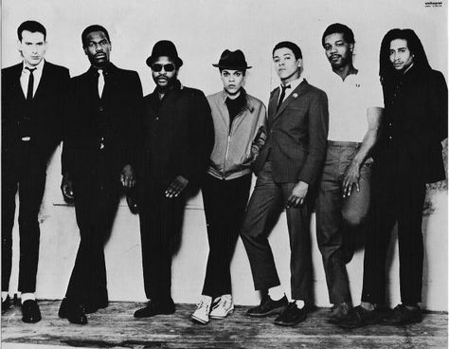
Types of Selectors
Type selectors
h1, p, body, etc.
Class selectors
.myClass
ID selectors
#myID
Attribute selectors
a[title]
Pseudo-classes and pseudo-elements
a:hover
P::first-line
Combinators
article > p

Slide 15
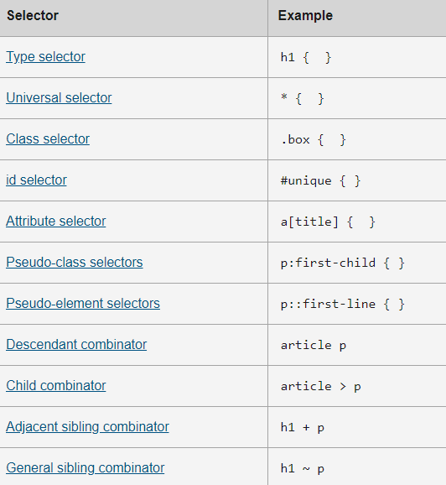

Slide 16

The Descendant Combinator
A very common combinator used to create specific rules
Simply list elements with a space between each one
article .button a { text-decoration: none; }
Applies this rule to <a> tags inside of an element with the .button class which is inside of an <article> tag
<a> tags that aren’t in .button or <article> won’t be affected

Slide 17
Child Combinator
>
Matches only direct children, not indirect children
article > p
Matches <p> tags directly inside of an <article> tag
Will match: <article> <p>This will match</p> <p>This will also match</p> </article>
Won’t match: <article><div><p>This is a paragraph</p></div></article>

Slide 18
Adjacent Sibling Combinator
+
Matches a selector immediately preceded by another selecter
h1 + p
Matches a <p> element directly after an h1 element
Will match <h1>This is a heading</h1> <p>This paragraph will match</p>
Won’t match <h1>This is a heading</h1> <img src=”moose.jpg”> <p>This paragraph won’t match</p>

Slide 19
Common CSS Pseudo-classes
:link
:visited
:active
:hover
:focus
:first-child
:last-child
:only-child

Slide 20
Fonts and Text Styling

Slide 21
Font Styling Properties
color
font-family
The typeface to use
font-size
font-style
normal, italic or oblique
font-weight
normal, bold, lighter, bolder
text-transform
none, uppercase, lowercase, capitalize, full-width
text-decoration
none, underline, overline, line-through

Slide 22

Text-Shadow
Complex enough to need its own slide
Takes in four properties:
Horizontal offset
Vertical offset
Blur radius
Base color
You can define multiple shadows

Slide 23
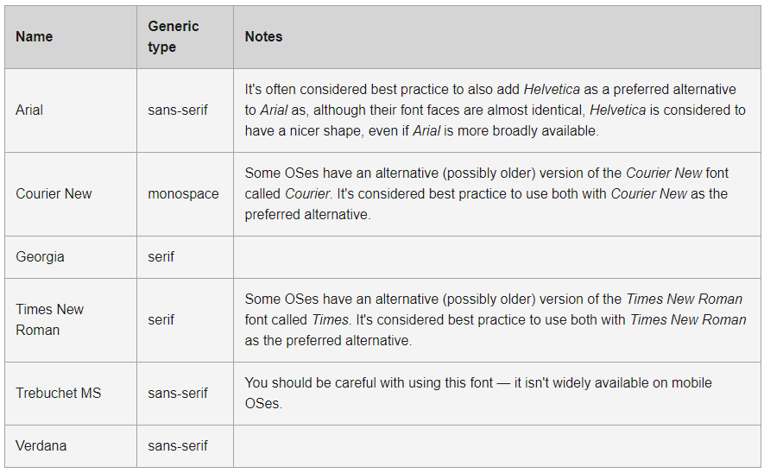
Web Safe Fonts

Slide 24
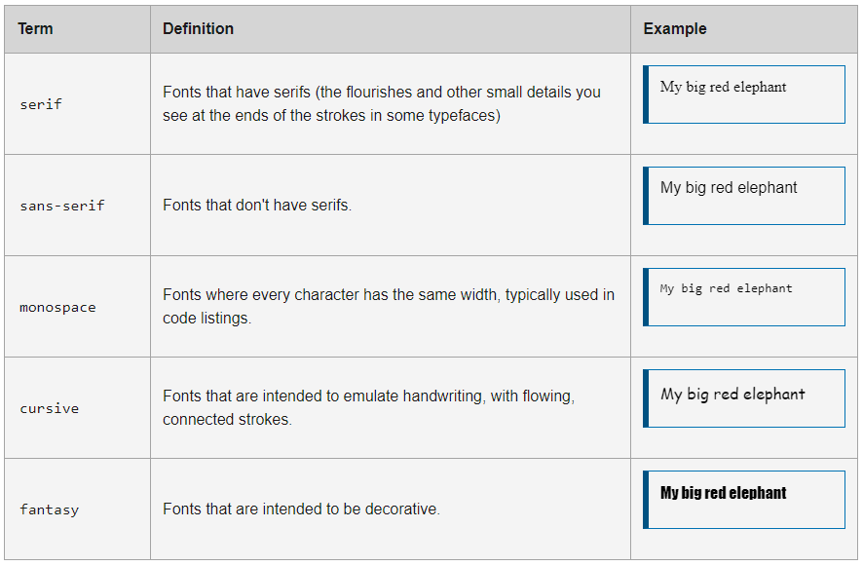
Default Fonts

Slide 25

Font Stacks
Since you can’t guarantee that a user will have a font you want to use, you can specify multiple fonts
The browser will choose the first font that’s available
You can leave a default font choice at the end for safety

Slide 26
Text-Layout Properties
text-align
left, right, center, justify
line-height
Height of each line of text (not the letters themselves, but the space the letters appear in)
letter-spacing and word-spacing
Space between each letter or word

Slide 27
Other Things to Know

Slide 28

Color
Can be specified multiple ways
A predefined color name (like “red”)
Via RGB values
Via Hexadecimal values (very commonly seen in web development)
Via HSL values
Via RGBA or HSLA

Slide 29
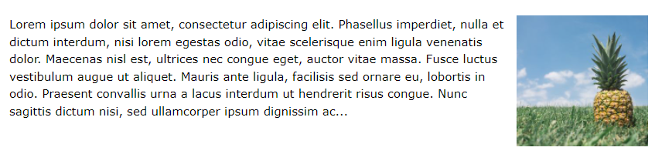

Float
The first (and most annoying) CSS Layout property we’ll learn
“Floats” an item to one side so that other content flows around it
Values: left, right, none, inherit

Slide 30

!important
CSS is all about elegantly letting things flow together from broad-level settings down into more specific page-level styles
!important throws all that out the window
If a property is marked as !important, it will override all other applied contradicting styles
Should be avoided as much as possible

